Slide 1

Customer Shopping Behavior Analysis
Leveraging consumer shopping data to identify trends, improve customer engagement, and optimize marketing and product strategies through Python, SQL, and Power BI.

Slide 2

The Challenge
Understanding Customer Behavior
A leading retail company noticed changes in purchasing patterns across demographics, product categories, and sales channels. Management needed insights into which factors drive consumer decisions and repeat purchases.
Key Questions: How do discounts, reviews, seasons, and payment preferences influence shopping behavior? What drives customer loyalty and engagement?

Slide 3
Project Deliverables
Data Preparation & Modeling
Data Analysis
Visualization & Insights
Structure data and run SQL queries to extract insights on customer segments and loyalty
Build interactive Power BI dashboard highlighting key patterns and trends
Clean and transform raw dataset using Python for comprehensive analysis
Report & Presentation
GitHub Repository
Communicate findings and actionable recommendations to stakeholders
Document all scripts, queries, and dashboard files in structured format

Slide 4

Data Preparation in Python
1
Handling Missing Values
37 null records in Review Rating column filled using median calculation with lambda functions
2
Column Standardization
Applied snake casing (column_name) to keep attributes generic and easy to query
3
Feature Engineering
Created age_group column to identify customer behavior patterns and purchase frequency metrics

Slide 5

Data Optimization
Removing Redundancy
Identified duplicate columns: discount_applied and promo_code_used both contained yes/no tagging with identical meaning.
Solution: Removed redundant column to streamline analysis and improve database efficiency.
Database Connection
Established PostgreSQL connection, creating customer_behaviour database with customer table containing all cleaned attributes for SQL analysis.

Slide 6
Key SQL Insights
Leveraging a comprehensive approach, Python was instrumental in the initial data preparation, cleaning, and exploratory analysis stages. Subsequently, SQL was utilized to query the refined database, extracting these specific insights into customer behavior and sales trends.
Revenue by Gender
Top 5 Products by Rating
Shipping Type Comparison
Analyzed total revenue distribution across gender segments
Identified highest-rated products with average customer ratings
Compared average purchase amounts between standard and express shipping
Discount-Dependent Purchases
Subscribers vs Non-Subscribers
Customer Segmentation
Categorized customers as new, returning, or loyal based on purchase frequency
Found top 5 products with highest percentage of discounted purchases
Compared average spend and total revenue between customer types

Slide 7

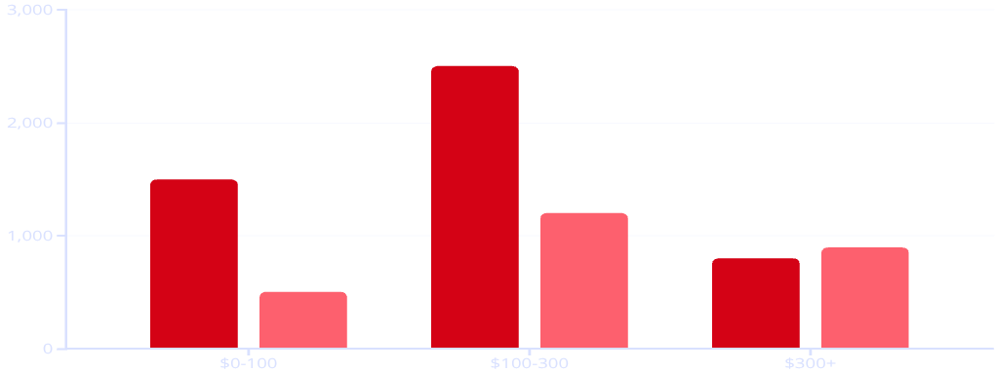

SQL Insights Visualizations
Revenue by Gender
Shipping Type Comparison
Subscriber Distribution
Standard Shipping
Express Shipping
Male
Female
Subscribers
Non-Subscribers

Slide 8

Advanced Analysis Findings
1
Top Products per Category
Identified top 3 most purchased products within each category for strategic positioning
2
Repeat Buyers & Subscriptions
Customers with 5+ previous purchases show higher subscription likelihood
3
Revenue by Age Group
Analyzed revenue contribution across different age demographics

Slide 9
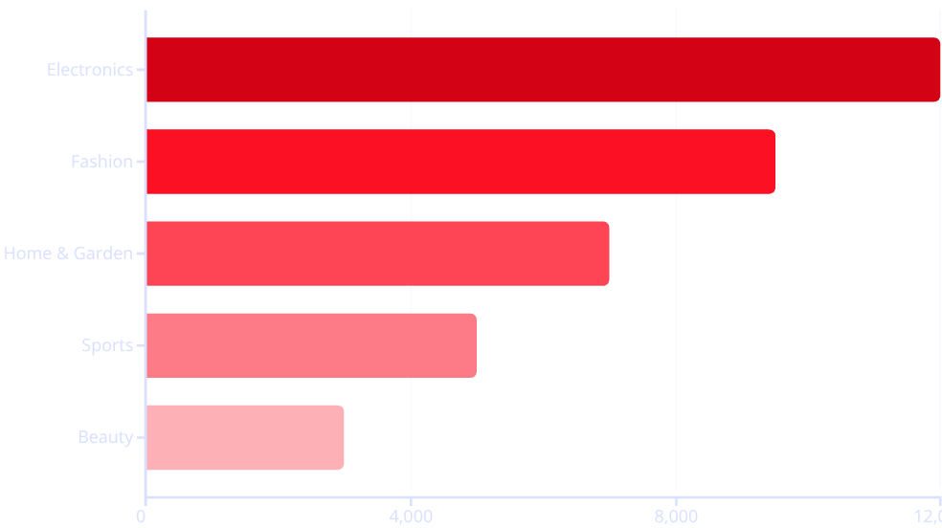
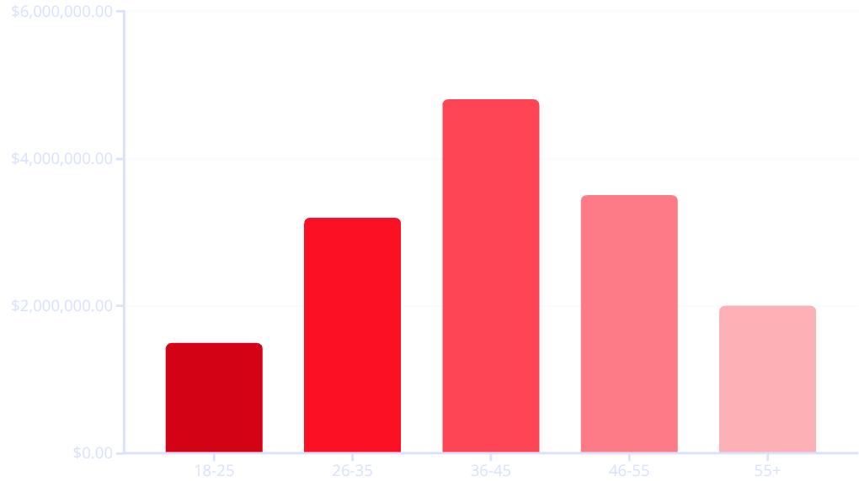
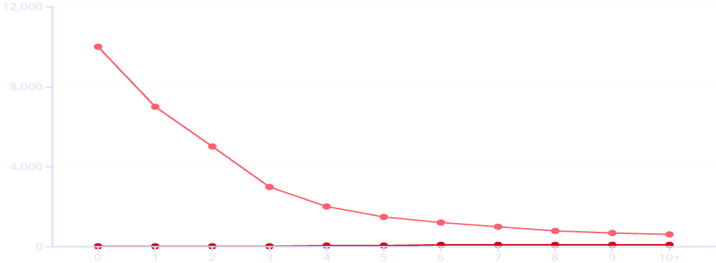
Advanced Analysis Visualizations
Top Products by Category
Repeat Buyers & Subscriptions
Revenue by Age Group
Subscription Likelihood (%)
Repeat Buyer Count

Slide 10

Power BI Dashboard
Interactive dashboard visualizes key performance metrics and behavioral trends, highlighting customer purchasing patterns, revenue distribution, discount impact, product ratings, and engagement metrics.
Empowering stakeholders to make informed, data-driven business decisions through intuitive visual storytelling.

Slide 11

Business Benefits
Customer Loyalty Programs
Boost Subscriptions
Review Discount Policy
Drive predictable recurring revenue and deepen long-term customer engagement
Optimize profitability by reducing unnecessary discounts while maintaining purchase influence
Strengthen retention, increase repeat purchases, and maximize customer lifetime value
Product Positioning
Targeted Marketing
Enhance visibility and alignment with customer needs to boost conversions
Improve campaign ROI through personalized, data-driven customer targeting

Slide 12

Transforming Data into Strategy
This project demonstrates how data engineering, statistical analysis, and business intelligence tools work together to transform raw data into meaningful strategic insights.
The Result: Improved customer engagement, targeted marketing campaigns, and optimized product and revenue strategies that drive measurable business growth.

